Slide 1
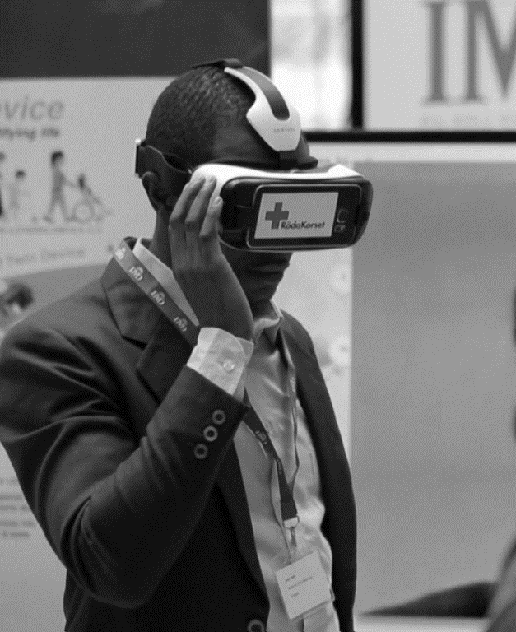

INNOVATION AT ICRC
International Rotary Club Geneva
Oct 2018

Slide 2







WHAT DOES INNOVATION MEAN TO THE ICRC?
Seeing problems in new ways and having an organizational culture that actively encourages creativity, testing, and learning from experience
Leveraging new or improved technology, products, and processes
Creating and strengthening partnerships
Recognizing that innovation happens everywhere across the organization
Dedicating financial and human resources to help achieve these goals
Notes:
Innovation = Tons of things happening in the different departments, unit, delegations…
Innovation = a way of answering to emerging needs or to improve our current responses. Need-based, not just because a technology looks cool – it has to answer a problem we’re facing in our specific context
More specifically, we identified the following elements to frame ‘ICRC innovation’:
- Seeing problems in new ways… And thinking “what else could we do about it?”. Innovation is a way to TEST these new things. So the objective of an innovation pilot is mainly to learn
- When we say ‘innovation’ most people associate it directly with technology… That’s not how we see it! We look at innovation in its broad sense and include any improvement / new product, service but also process (e.g. way of doing things)
- Creating and strengthening partnerships – with the private sector, academia, and international and local organizations – for research, technology, and expertise
- Recognizing that innovation happens everywhere across the organization and can be supported by anyone looking for new ways to do their work better
- Dedicating financial and human resources to help achieve these goals

Slide 3
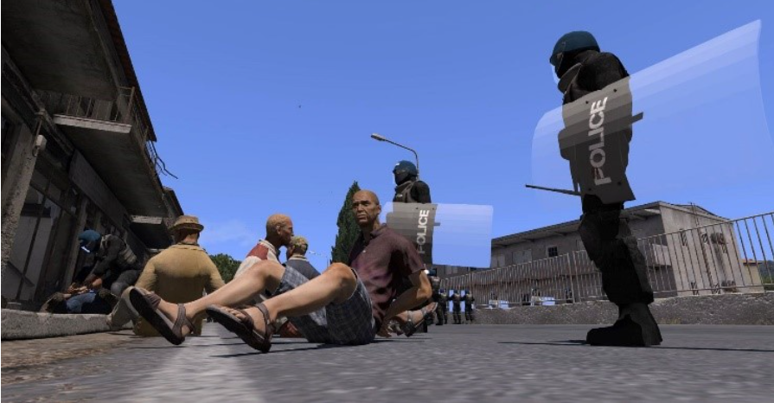
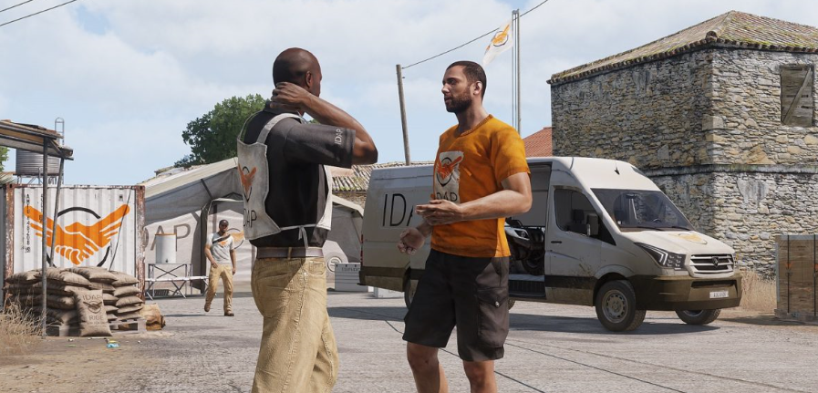
VIRTUAL & AUGMENTED REALITY

Slide 4
DIGITALIZATION
The rise of the ‘connected beneficiary’
Data privacy as protection
AI & impartial humanitarian action
Misinformation and the changing nature of war

Slide 5
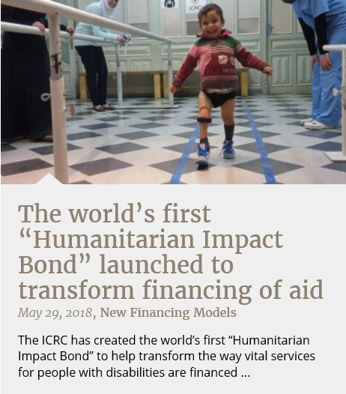
NEW FINANCING MODELS

Slide 6




A FEW EXAMPLES OF CURRENT INITIATIVES
Environmentally sustainable products & practices – from greening the humanitarian response to powering new technologies – that strengthen resilience
Insights from behavioral science to reduce violence in hospitals in Pakistan
Facial recognition technology that improves the matching capability of the Trace the Face website
An affordable prosthetic foot that allows people to walk longer and faster

